Slide 1
Data Communication and
Networks
Dr.S.Sathya Priya

Slide 2
Local Area Networks

Slide 3
Overview
Introduction
Project 802
Ethernet
Token ring
Token Bus

Slide 4
Introduction
Data communication system
Allows a number of independent devices to communicate directly with each other in a limited geographic area.
dominated by four architectures:
Ethernet,
Token Bus,
Token Ring, and
Fiber distributed data interface (FDDI).

Slide 5
PROJECT 802
In 1985, the Computer Society of the IEEE started a project, called Project 802
IEEE has standardized a number of local area networks and metropolitan area networks under the name of IEEE 802.
To set standards to enable intercommunication between equipment from a variety of manufacturers.
Project 802 does not seek to replace any part of the OSI model.
IEEE has subdivided the data link layer into two sublayers:
Logical Link Control (LLC)
Medium Access Control (MAC)

Slide 6
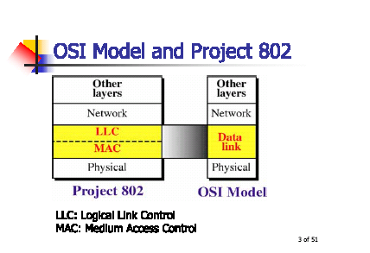

Slide 7
Strength of Project 802 is modularity.
In IEEE Project 802, flow control, error control, and part of the framing duties are collected into one sublayer called the logical link control.
Framing is handled in both the LLC sublayer and the MAC sublayer.
Each subdivision is identified by a number.
Each subdivision is necessary for LAN management.
  802.1 (internetworking )
  802.2(LLC)
  802.3 (CSMA/CD)
  802.4 (Token Bus)
  802.5 (Token Ring) and others.

Slide 8
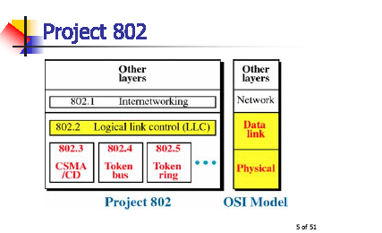

Slide 9

IEEE 802.1
Project 802 devoted to internetworking issues in LANs and MANs.
It assures the compatibility of different LANs and MANs across protocols.

Slide 10
LLC(IEEE 802.2)
LLC is non-architecture-specific;
LLC provides one single data link control protocol for all IEEE LANs.
In this way, the LLC is different from the media access control sublayer, which provides different protocols for different LANs.
A single LLC protocol can provide interconnectivity between different LANs because it makes the MAC sublayer transparent.

Slide 11
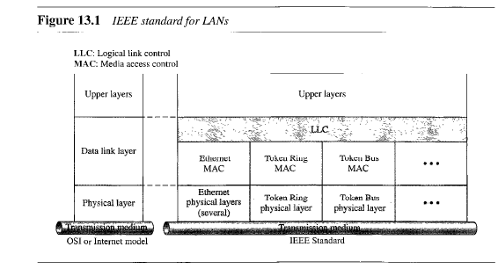
shows one single LLC protocol serving several MAC protocols.

Slide 12
Need for LLC
purpose of the LLC is to provide flow and error control for the upper-layer protocols that actually demand these services.
For example, if a LAN or several LANs are used in an isolated system, LLC may be needed to provide flow and error control for the application layer protocols.
However, most upper-layer protocols such as IP , do not use the services of LLC

Slide 13
MAC
Second set MAC sublayer, resolves the contention for the shared media.
It contains the synchronization, flag, flow and error control specifications necessary to move information from one place to another.
MAC protocols are specific to the LAN using them (Ethernet, Token Ring, and Token bus etc)

Slide 14
Protocol Data Unit (PDU)
The data unit in the LLC level is called the PDU.
The PDU contains four fields familiar from HDLC.
    Destination service access point (DSAP),
    Source service access point (SSAP),
    Control field and
    Information field.
DSAP and SSAP are addresses used by the LLC to identify the protocol stacks on the receiving and sending machines.

Slide 15
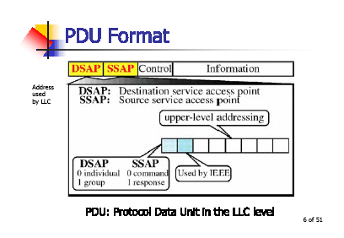
First bit of the DSAP indicates whether the frame is intended for an individual or a group.
First bit of the SSAP indicates whether the communication is a command or response PDU.

Slide 16
Control
Identical to the control field in HDLC.
PDU frames can be I-frames, S-frames, or U-frames and carry all of the codes and information that the corresponding HDLC frames carry.
PDU has no flag fields, no CRC and no station address.
These fields are added in the lower sublayer (the MAC layer)

Slide 17
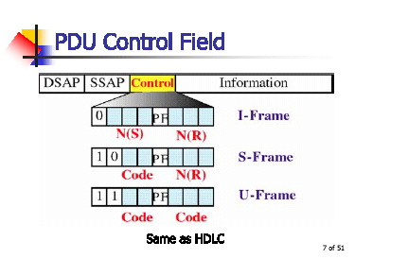

Slide 18
ETHERNET
IEEE 802.3 supports a LAN standard originally developed by Xerox.
Ethernet was created in 1976 at Xerox’s Palo Alto Research Center (PARC).
Digital Equipment Corporation, Intel Corporation and Xerox.
IEEE 802.3 defines two categories: baseband and broadband.
  Base specifies a digital signal (in this case, Manchester encoding).
  Broad specifies an analog signal (PSK encoding).

Slide 19
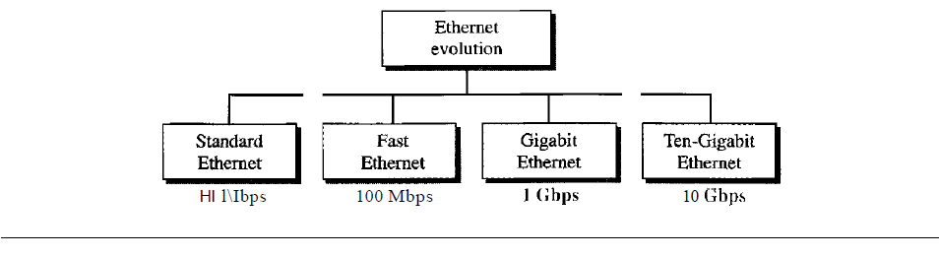
The access mechanism used in an Ethernet is called Carrier Sense Multiple Access with Collision Detection (CSMA/CD).
10Base5, 10Base2, 10Base-T, 1Base5 and 100Base-T, .

Slide 20
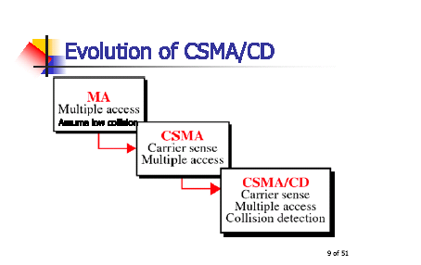
Access Method: CSMA/CD
Whenever multiple users have unregulated access to a single line, there is a danger of signals overlapping and destroying each other.
Such overlaps, which turn the signals into unusable noise are called collisions.

Slide 21
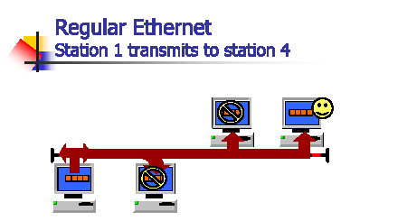

Slide 22
Electrial Specification
Signaling
  baseband systems are Manchester digital encoding
Data Rate
Ethernet LANs can support data rates between 1 and 10 Gbps.
Frame Format
IEEE 802.3 specifies one type of frame containing seven fields: preamble, SFD, DA, SA, length/type of PDU, 802.3 frame and the CRC.

Slide 23
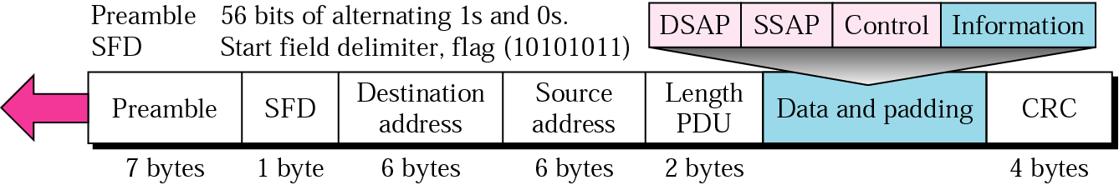
802.3 MAC frame
Acknowledgement must be implemented at the higher layers
Preamble: The first field of the 802.3 frame, the preamble contains 7 bytes (56 bits) of alternating 0s and 1s that alert the receiving system to the coming frame and enable it to synchronize its input timing. The pattern 1010101 provides only an alert and a timng pulse

Slide 24
Start frame delimited (SFD): The second field (one byte: 10101011) of the 802.3 frame signals the beginning of the frame.
Destination address (DA): The destination address (DA) field is allotted six bytes and contains the physical address of the packet’s next destination.
  A system's physical address is a bit pattern encoded on its NIC.
  Each NIC has a unique address that distinguishes it from any other NIC.

Slide 25
Source address (SA): The source address (SA) field is also allotted six bytes and contains the physical address of the last device to forward the packet.
Length/type of PDU: These next two bytes indicate the number of bytes in the coming PDU.

Slide 26
802.2 frame (PDU):
PDU can be anywhere from 46 to 1500 bytes long, depending on the type of frame and length of the information field.
PDU is generated by the upper (LLC) sublayer, then linked to the 802.3 frame.
CRC:
last field in the 802.3 frame contains the error detection information, in this case a CRC-32.

Slide 27
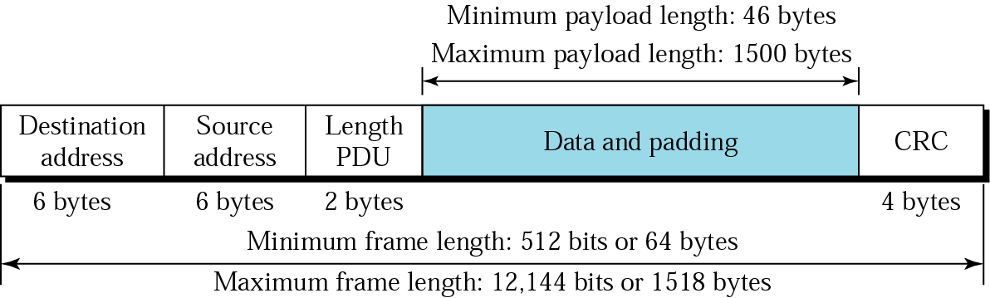
Frame Length
Minimum length is required for the correct operation of CSMA/CD.
If there is a collision before the physical layer sends a frame out of a station, it must be heard by all stations.

Slide 28
Frame Length
If the entire frame is sent out before a collision is detected, it is too late.
MAC layer has already discarded the frame, thinking that the frame has reached the destination.
So frame length reduces in size, it sent out faster.
For 10-Mbps Ethernet LAN as 512 bits or 64 bytes.

Slide 29
Frame Length
Maximum length is required for the correct operation of CSMA/CD.
First, memory was very expensive when Ethernet was designed: a maximum length restriction helped to reduce the size of the buffer.
Second, it prevents one station from monopolizing the shared medium, blocking other stations that have data to send.

Slide 30

Ethernet addresses in hexadecimal notation
Each station on a Ethernet network has its own NIC.
It provides 6-byte physical address.
Normally written in hexadecimal notation.

Slide 31
Unicast, Multicast, and Broadcast Addresses
Source address is always unicast – frame comes from only one station.
Destination address can be unicast, multicast, or broadcast.
Unicast – relationship between the sender and the receiver is one-to-one.
Multicast – relationship between the sender and the receiver is one-to-Many.
Broadcast – is a special case of multicast. A destination broadcast address is forty-eight 1s.

Slide 32
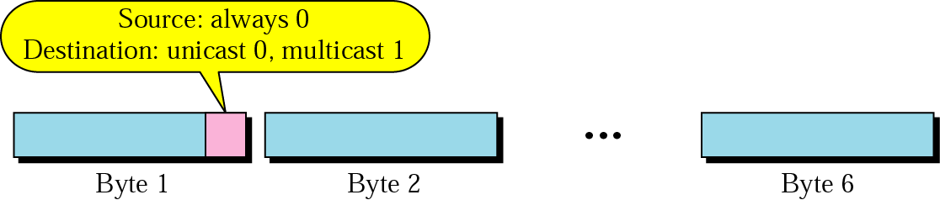
Unicast and multicast addresses

Slide 33
Access Method: CSMA/CD
Standard Ethernet uses 1-persistent CSMA/CD.
Slot Time:
Ethernet network, the round-trip time required for a frame to travel from one end of a maximum-length network to the other plus the time needed to send the jam sequence is called the slot time.
Slot time = round-trip time + time required to send the jam sequence
slot time in Ethernet is defined in bits.
It is the time required for a station to send 512 bits.
This means that the actual slot time depends on the data rate; for traditional 10Mbps Ethernet it is 51.2 μs.

Slide 34
Slot Time and Collision
choice of a 512-bit slot time is allow the CSMA/CD proper functioning
To understand the situation, let us consider two cases:
First case:
Assume that the sender sends a minimum-size packet of 512 bits.
Before the sender can send the entire packet out, the signal travels through the network and reaches the end of the network.
If there is another signal at the end of the network (worst case), a collision occurs.
The sender has the opportunity to abort the sending of the frame and to send a jam sequence to inform other stations of the collision.

Slide 35
round-trip time plus the time required to send the jam sequence should be less than the time needed for the sender to send the minimum frame, 512 bits.
sender needs to be aware of the collision before it is too late, that is, before it has sent the entire frame.

Slide 36
Slot Time and Collision
second case:
sender sends a frame larger than the minimum size (between 512 and 1518 bits).
if the station has sent out the first 512 bits and has not heard a collision, it is guaranteed that collision will never occur.
reason is that the signal will reach the end of the network in less than one-half the slot time.
If all stations follow the CSMA/CD protocol, they have already sensed the existence of the signal (carrier) on the line and have refrained from sending.

Slide 37
Slot Time and Collision
second case:
If they sent a signal on the line before one-half of the slot time expired, a collision has occurred and the sender has sensed the collision.
In other words, collision can only occur during the first half of the slot time, and if it does, it can be sensed by the sender during the slot time.
This means that after the sender sends the first 512 bits, it is guaranteed that collision will not occur during the transmission of this frame.
The medium belongs to the sender, and no other station will use it.
In other words, the sender needs to listen for a collision only during the time the first 512 bits are sent.

Slide 38

Slot Time and Maximum Network Length
There is a relationship between the slot time and the maximum length of the network (collision domain).
It is dependent on the propagation speed of the signal in the particular medium.
In most transmission media, the signal propagates at 2 x 10⁸ ms (two-thirds of the rate for propagation in air).
For traditional Ethernet, we calculate
  MaxLength = PropagationSpeed x SlotTime/2
  MaxLength = (2x 10⁸) X(51.2 X 10⁻⁶ /2) = 5120m
Of course, we need to consider the delay times in repeaters and interfaces, and the time required to send the jam sequence.

Slide 39
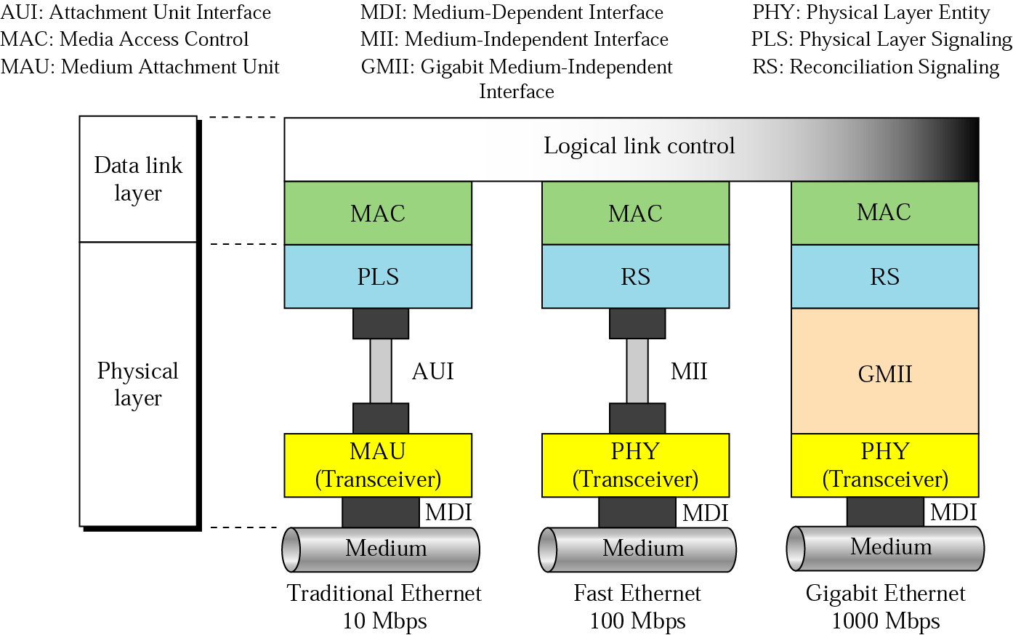
Three generations of Ethernet

Slide 40
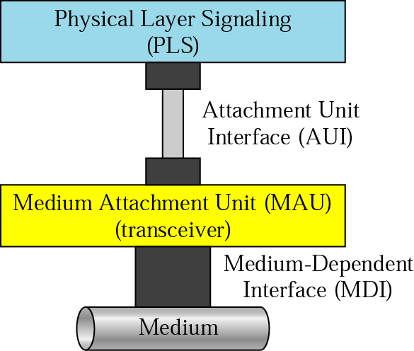
Physical layer

Slide 41
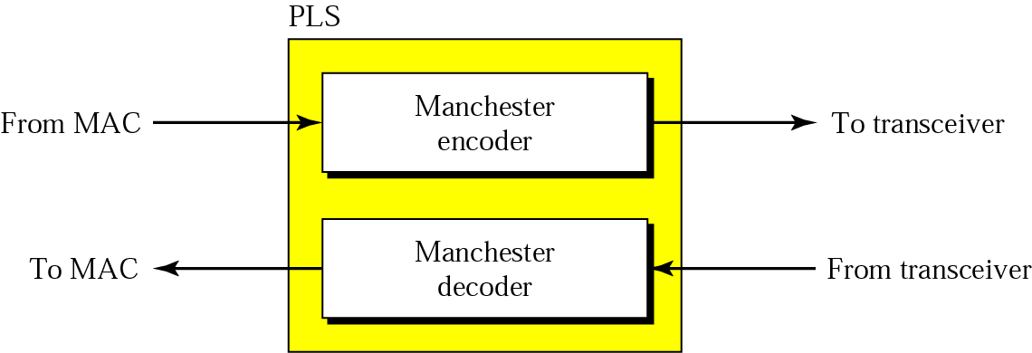
PLS
PLS sublayer
  It encodes and decodes data.
  Traditional Ethernet uses Manchester encoding.

Slide 42
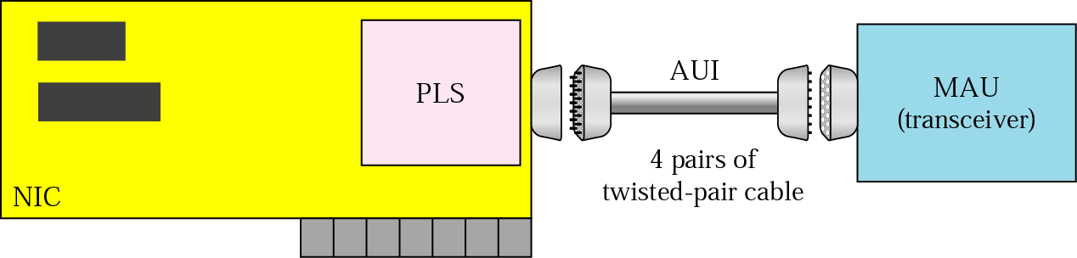
AUI
It is a specification that defines the interface between the PLS and MAU.
It was designed for the first implementation of Ethernet, which used thick coaxial cable.
Idea was, future to connect the PLS sublayer to a different MAU.

Slide 43
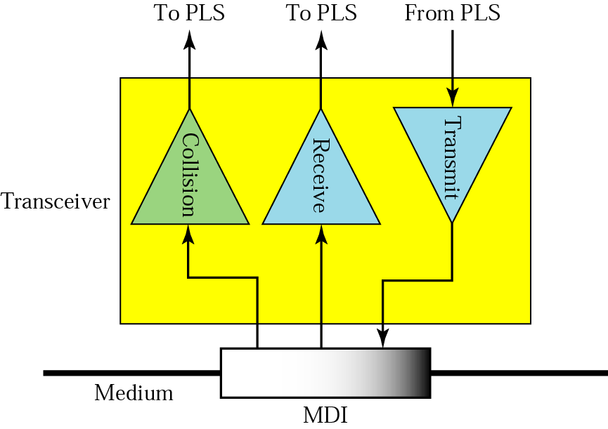
MAU (transceiver)
It is a transmitter and a receiver.
It transmits and receives signals over the medium. Also detects collisions.
Medium-dependent. It creates the appropriate signal for each particular medium.

Slide 44
MAU (transceiver)
MAU for each type of medium used in 10-Mbps Ethernet.
It performs the CSMA/CD function of checking for voltages and collision on the line and may contain a small buffer.
It also serves as a connector that attaches a station to the thick coaxial cable via a tap.
It can be external or internal.
External – close to the media and is connected via an AUI to the station.
Internal – installed in NIC – does not need an AUI cable.

Slide 45
Medium-Dependent Interface (MDI)
To connect MAU, we need MDI. Just a piece of Hardware for connecting a MAU.
External – it can be a tap or Tee connector.
Internal – it can be a jack.

Slide 46
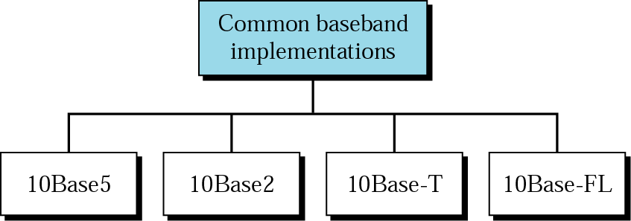
Figure 14.10 Categories of traditional Ethernet

Slide 47
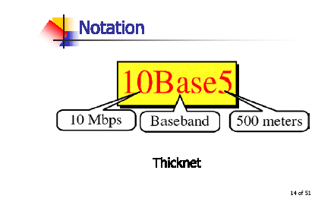
10BASE5: Thick Ethernet
First physical standards defined in the IEEE 802.3 model is called 10Base5, thick Ethernet or Thicknet.
10Base5 is a bus topology LAN that uses baseband signaling and has a maximum segment length of 500 meters.

Slide 48
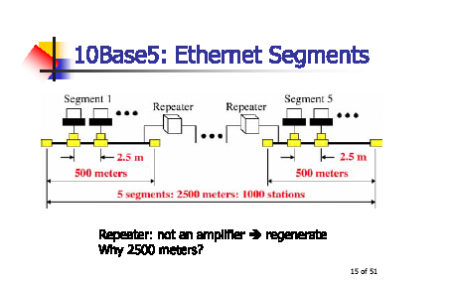

Slide 49
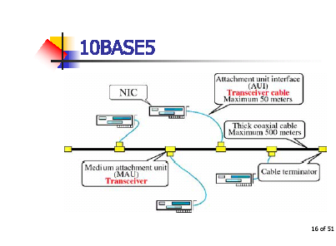

Slide 50
RG-8 Cable:
RG-8 cable (RG stands for radio government) is a thick coaxial cable that provides the backbone of the IEEE 802.3 standard.
Transceiver:
Each station is attached by an AUI cable to an intermediary device called a medium attachment unit (MAU) or more commonly a transceiver (short for transmitter-receiver).

Slide 51
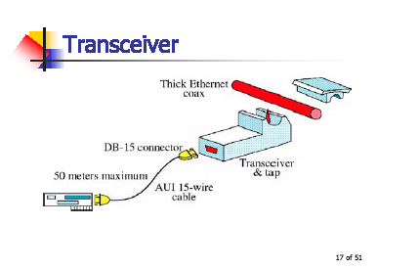
Transceiver:
Each station is attached by an AUI cable to an intermediary device called a medium attachment unit (MAU) or more commonly a transceiver (short for transmitter-receiver).

Slide 52
AUI Cables:
Each station is linked to its corresponding transceiver by an attachment unit interface (AUI), also called a transceiver cable.
AUI is a 15-wire cable with plugs that performs the physical layer interface functions between the station and the transceiver.
Each end of an AUI terminates in a DB-15 (15-pin) connector.

Slide 53
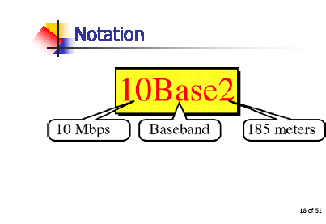
10BASE2: Thin Ethernet
Second Ethernet implementation defined by the IEEE 802 series is called 10Base2 or thin Ethernet.
Thin Ethernet (also called Thinnet, cheapnet, cheapernet and thinwire Ethernet) provides a inexpensive alternative to 10Base5 Ethernet with the same data rate.
Thin Coaxial Cable: The cable required to implement the 10Base2 standard

Slide 54
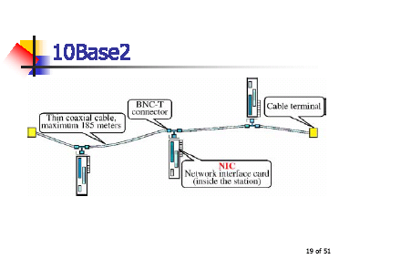
It is a bus topology LAN.
The advantages are thin Ethernet are reduced cost and ease of installation.
The disadvantages are shorter range and smaller capacity. Cable standard is RG58.

Slide 55
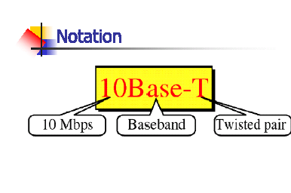
10BASE-T: Twisted-Pair Ethernet
Popular standard defined in the IEEE 802.3 series is 10Base-T (also called twisted-pair Ethernet), a star-topology LAN using unshielded twisted pair (UTP) cable instead of coaxial cable.
Maximum length (hub to station) of 100 meters.

Slide 56
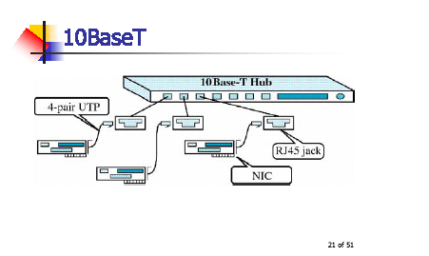

Slide 57
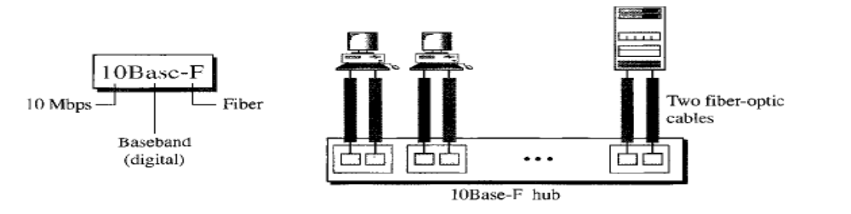
10Base-F: Fiber Link Ethernet
Uses Star topology.
Normally implemented using an external transceiver called fiber-optic MAU.
Station is connected to the external transceiver by an AUI cable.
Transceiver is connected to the hub by using 2 pairs of fiber-optic cables.

Slide 58
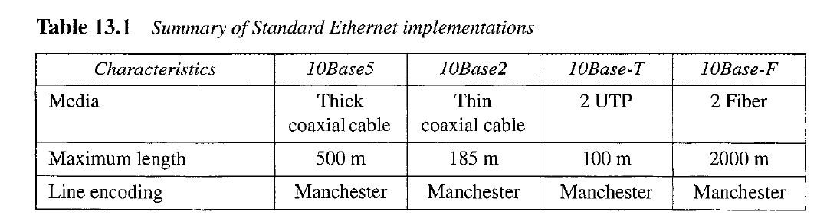

Slide 59
Bridged Ethernet
First step in the Ethernet evolution was the division of a LAN by bridges.
Bridges have 2 effects on an Ethernet LAN:
raises BW and
separate collision domains.

Slide 60
Raising Bandwidth
Unbridged Ethernet network, total capacity is shared between all the stations with a frame to send.
If only one station has frames to send, it benefits from the total capacity (10 Mbps).
Bridges divides the network into 2 or more networks.
Bandwidthwise, each network is independent.
Network with 12 stations is divided into 2 networks, each with 6 stations.
Now each network with a capacity of 10 Mbps.

Slide 61
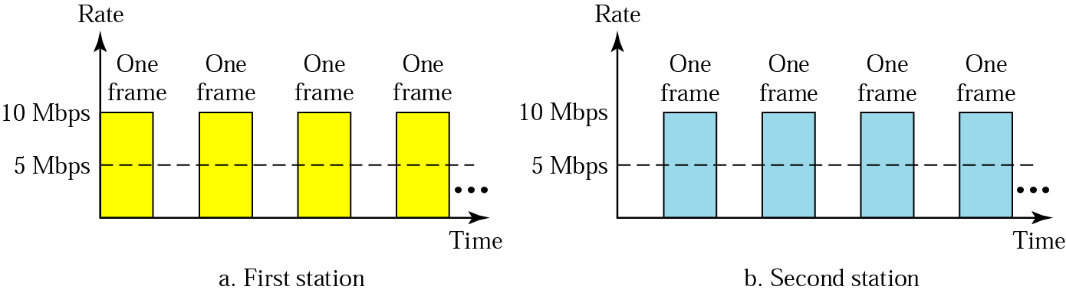
Sharing bandwidth

Slide 62
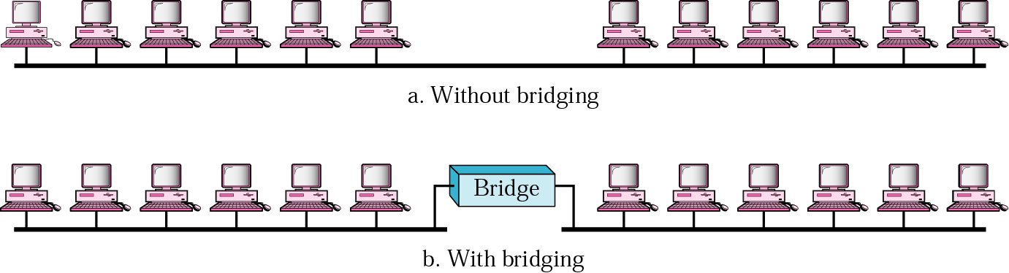
A network with and without a bridge
Advantage of a bridge is the separation of the collision domain.
Collisions domains becomes smaller and the probability of collisions is reduced.

Slide 63
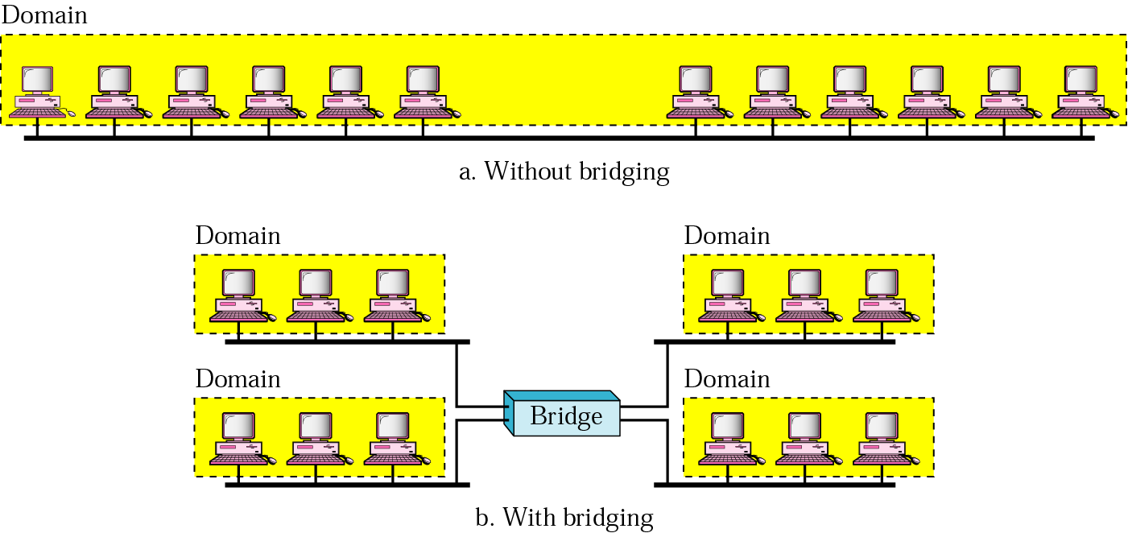
Collision domains in a nonbridged and bridged network

Slide 64
Switched Ethernet
Idea of a bridged LAN can be extended to a switched LAN.
Bandwidth is shared only between the station and the switch.
Switched Ethernet is an attempt to improve the performance of 10Base-T Ethernet.
The 10Base-T Ethernet is a shared media network, which means that the entire media is involved in each transmission.
This is because the topology, through physically a star, is logically a bus.

Slide 65
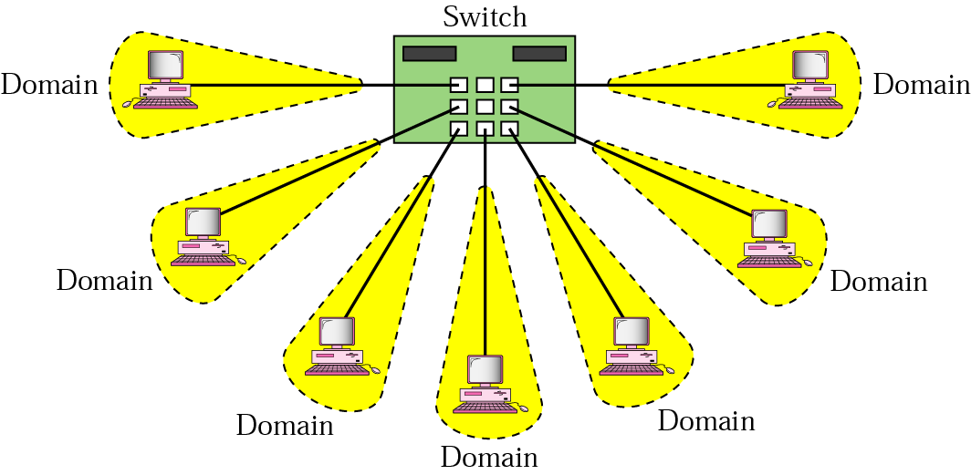
Replace the hub with a switch, a device that can recognize the destination address and can route the frame to the port to which the destination station is connected.
Increased the capacity of the network

Slide 66
Full-Duplex Ethernet
One of the limitations of 10Base5 and 10Base2 is half duplex.
10Base-T is always full duplex.
Next step to move from switched Ethernet to full-duplex Ethernet.
It increases the capacity of each domain from 10 to 20 Mbps.
No need for the CSMA/CD method. Here each station is connected via 2 separate links.

Slide 67
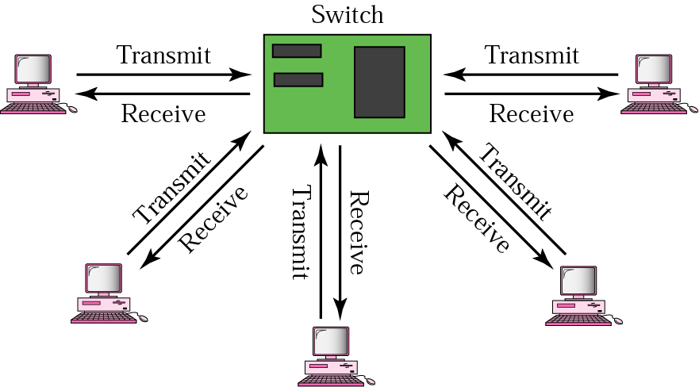
Full-duplex switched Ethernet

Slide 68
Fast Ethernet
Fast Ethernet operates at 100 Mbps.
The collision domain of Ethernet is limited to 2500 meters.
Fast Ethernet is a version of Ethernet with a 100 Mbps data rate.
In the physical layer, the specification developed for Fast Ethernet is a star topology similar to 10Base-T;
The whole idea in the evolution of Ethernet from 10 to 100 Mbps is to keep the MAC sublayer untouched.
IEEE has designed two categories of Fast Ethernet:
100Base-X and 100Base-T4.
100Base-X itself is divided into two types:
100Base-Tx
100Base-FX

Slide 69
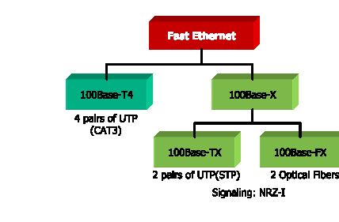

Slide 70
Autonegotitation:
New feature added to Fast Ethernet.
Allows 2 devices to negotiate the mode or data rate of operation.
Designed for the following purposes:
To allow incompatible devices to connect one another.
To allow one device to have multiple capabilities.
To allow a station to check a hub’s capabilities

Slide 71
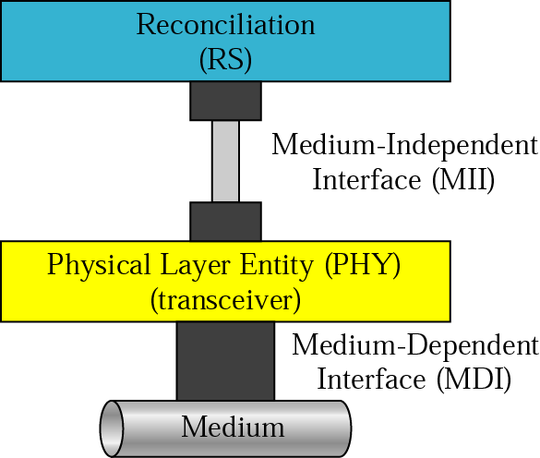
Physical Layer
Physical layer is made up of 4 sublayers.
RS, MII, PHY, and MDI.
Reconciliation sublayer is common to all implementations.
PHY and MDI are medium-dependent.

Slide 72
Reconciliation Sublayer
Replaces the PLS sublayer in 10 Mbps Ethernet.
Encoding and decoding performed by the PLS, are moved to PHY sublayer (transceiver) because encoding in Fast Ethernet is medium-dependent.
Mainly passing of data in 4-bit format to the MII.

Slide 73
Medium-independent Interface (MII)
AUI replaced with the MII.
Improved interface to work with 10 and 100 Mbps.

Slide 74
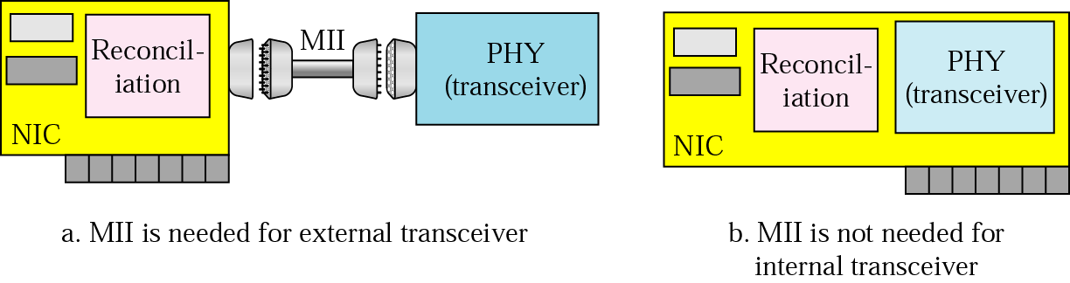
MII

Slide 75
PHY (Transceiver)
Transceiver in Fast Ethernet is called the PHY sublayer.
Responsible for encoding and decoding.
MDI
To connect the transceiver (internal or external) to the medium, we need MDI.

Slide 76
Physical Layer Implementation
Categorized as either a 2-wire or 4-wire implementation.
2-wire is called as 100Base-X, which can be either twisted-pair cable (100Base-TX) or fiber-optic cable (100Base-FX).
4-wire is designed only for twisted-pair cable (100Base-T4).

Slide 77
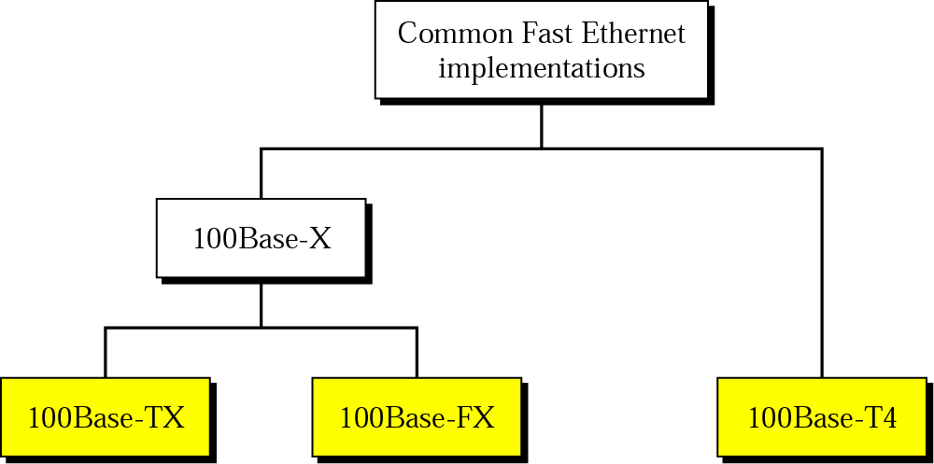
Fast Ethernet implementations

Slide 78
100Base-TX
100Base-TX design uses two category 5 (CAT 5) unshielded twisted-pair (UTP) or two shielded twisted (STP) cables to connect a station to the hub.
One pair is used to carry frames from the station to the hub and the other to carry frames from the hub to the station.
The encoding is 4B/5B to handle the 100 Mbps;
Signaling is NRZ-I. The distance between the station and the hub (or switch) should be less than 100 meters

Slide 79
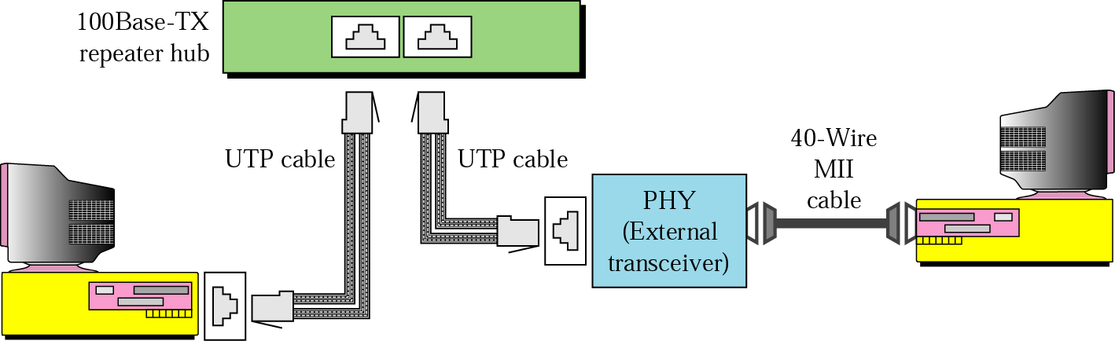
Figure 14.23 100Base-TX implementation

Slide 80
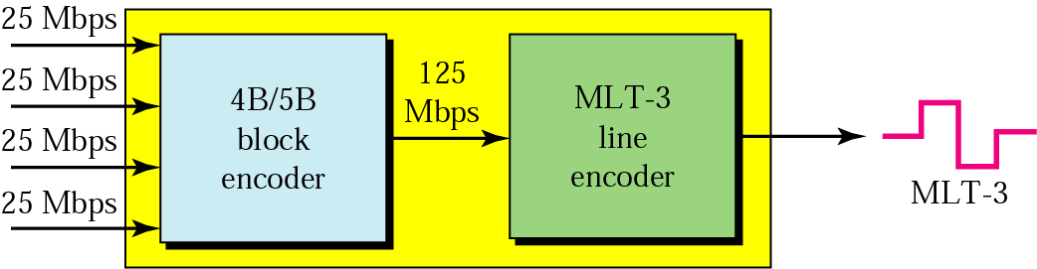
Figure 14.24 Encoding and decoding in 100Base-TX

Slide 81
100Base-FX
The 100Base-FX design uses two optical fibers, one to carry frames from the station to the hub and the other from the hub to the station.

Slide 82
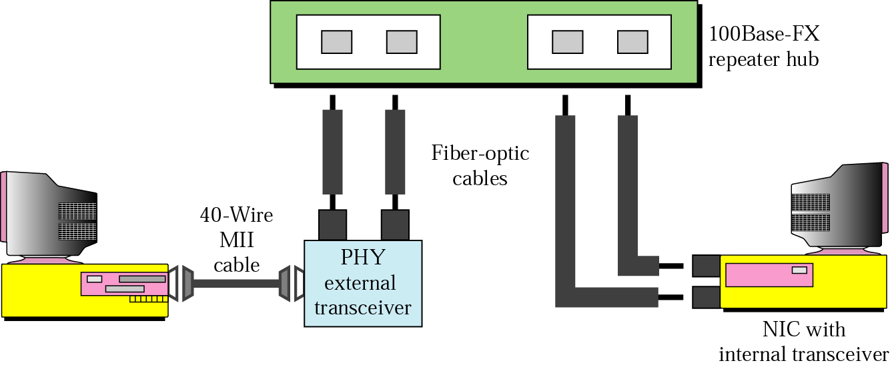
Figure 14.25 100Base-FX implementation

Slide 83
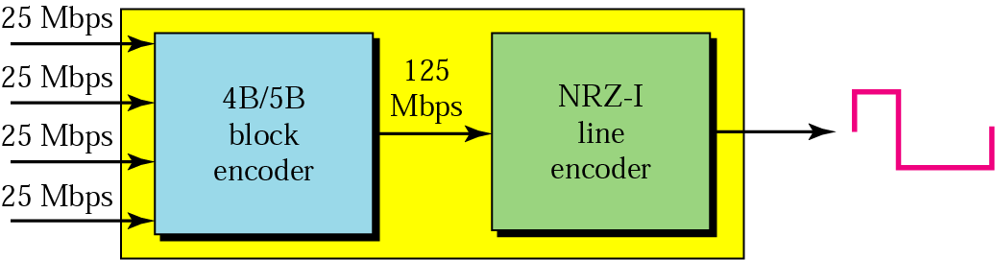
Figure 14.26 Encoding and decoding in 100Base-FX
Star topology.
Implementation allows either an external or an internal transceiver.
Responsible of Transceiver is same as above.
Encoding and decoding same as above.
But the data at the 125 Mbps rate are then encoded into a signal using NRZ-I.

Slide 84
100Base-T4
The 100Base-T4 scheme was designed in an effort to avoid rewiring.
It requires four pairs of category 3 (voice grade) UTP that are already available for telephone service inside most buildings.

Slide 85
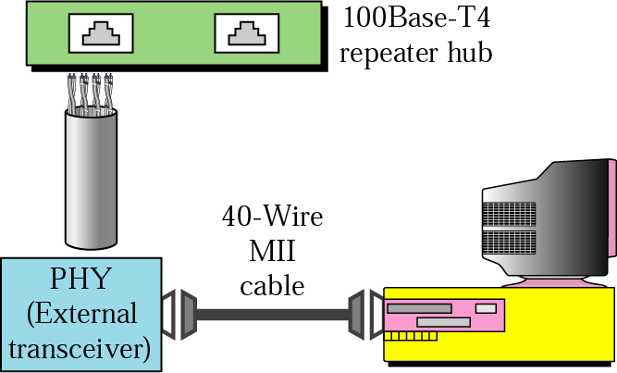
Figure 14.27 100Base-T4 implementation

Slide 86
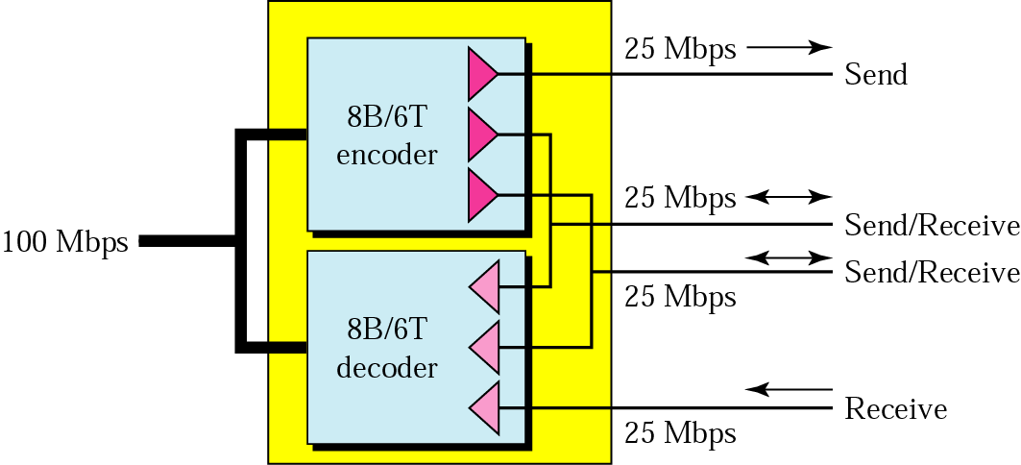
Figure 14.28 Using four wires in 100Base-T4

Slide 87
Gigabit Ethernet
Data rate of 1000 Mbps or 1 Gbps .
MAC layer and the access method remain the same but the collision domain is reduced.

Slide 88
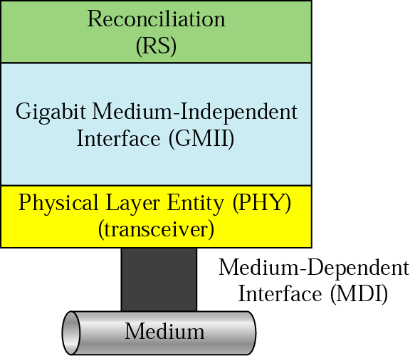
Figure 14.29 Physical layer in Gigabit Ethernet
Physical layer
Made up of 4 sublayers: reconciliation, GMII, PHY, and MDI.
Reconciliation
It sends 8-bit parallel data to the PHY sublayer via a GMII interface.

Slide 89
Figure 14.29 Physical layer in Gigabit Ethernet
GMII
Not an external physical component. No GMII cable or connector.
MDI
MDI connects the transceiver to the medium. Only RJ45 and fiber-optic connectors are defined.

Slide 90
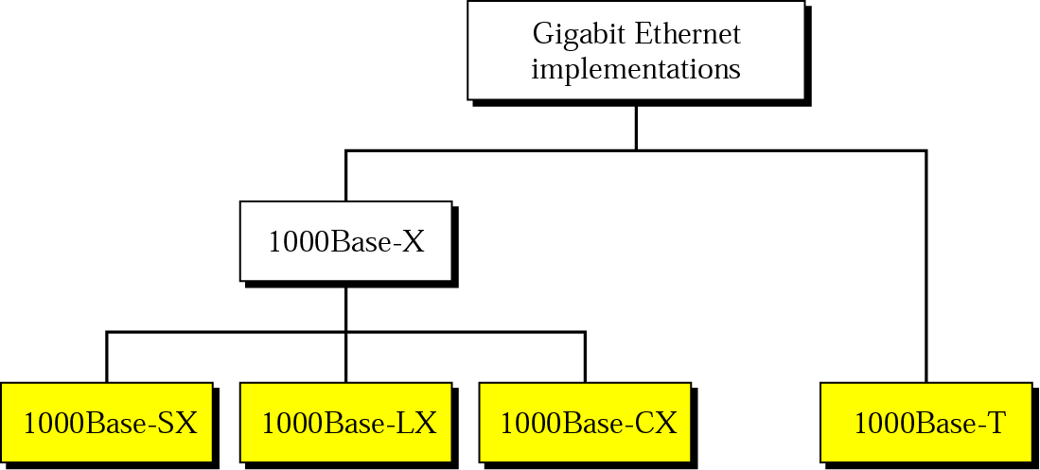
Figure 14.30 Gigabit Ethernet implementations

Slide 91
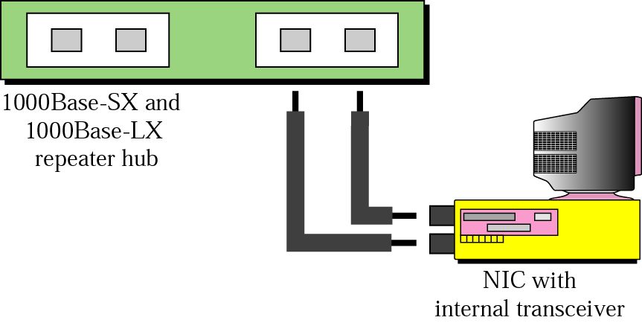
Figure 14.31 1000Base-X implementation
Both 1000Base-SX and 1000Base-LX use 2 fiber-optic cables. Only difference between them is that the type Laser.

Slide 92
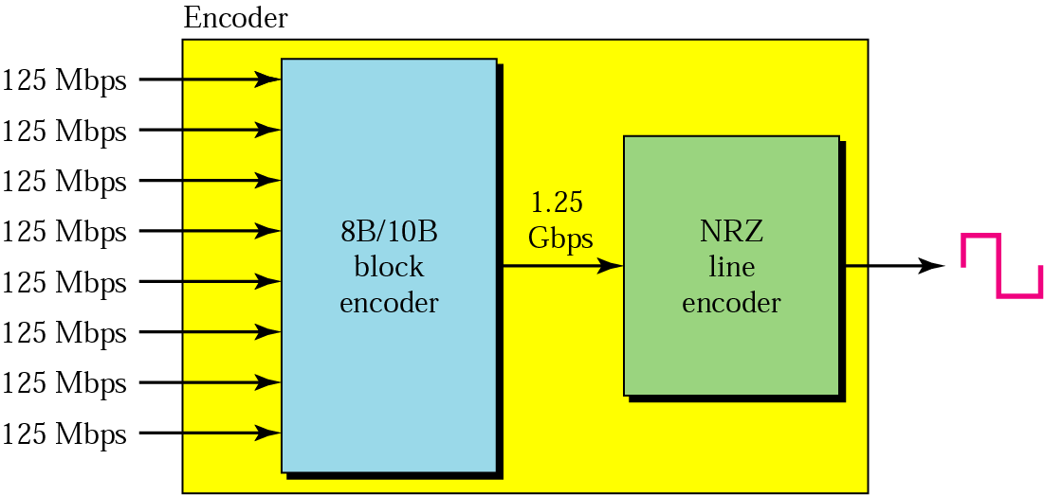
Figure 14.32 Encoding in 1000Base-X
To maintain synchronization, the encoder first performs block encoding.
8 parallel bits received from the NIC is encoded into 10 serial bits using 8B/10B.
The data at the 1.25Gbps rate are then encoded into a signal using NRZ encoding.

Slide 93
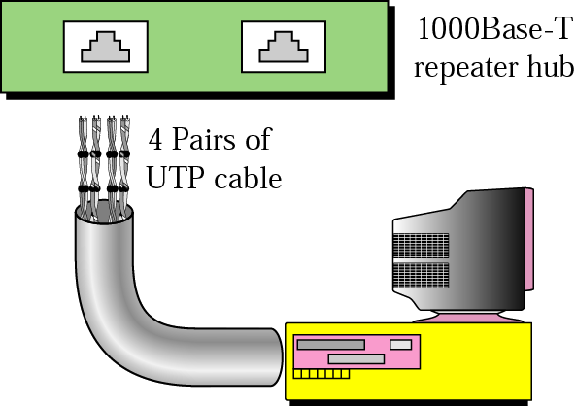
Figure 14.33 1000Base-T implementation
Use CAT 5 or CAT 6 or CAT 7 cables.
4 twisted pairs achieve a transmission rate of 1 Gbps.

Slide 94
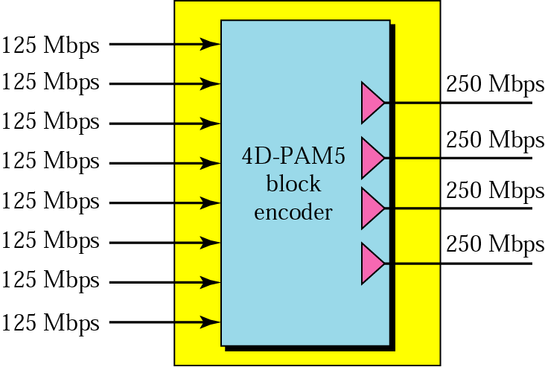
Figure 14.34 Encoding in 1000Base-T

Slide 95
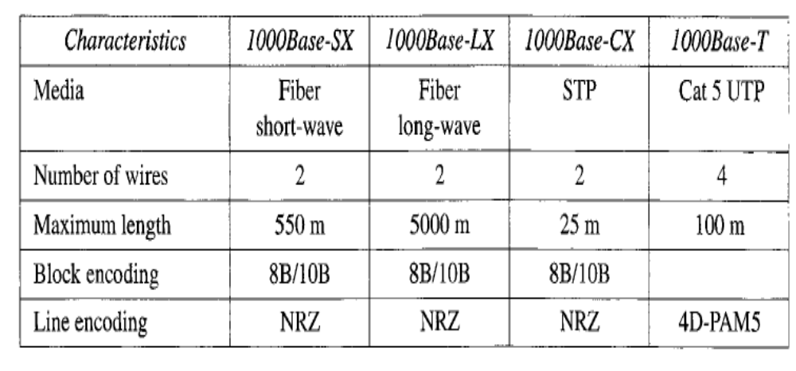

Slide 96
Ten Gigabit Ethernet
Ten-Gigabit Ethernet is called as Standard 802.3ae
Make it compatible with Standard, Fast, and Gigabit Ethernet
Allow the interconnection of existing LANs into a metropolitan area network (MAN) or a wide area network (WAN).
Make Ethernet compatible with technologies such as Frame Relay and ATM

Slide 97
MAC Sublayer
works in full duplex mode which doesn’t need any contention
Doesn’t use CSMA/CD
Physical Layer
Designed for fiber-optic cables over long distances
Three implementations are the most common: lOGBase-S, lOGBase-L, and lOGBase-E.

Slide 98
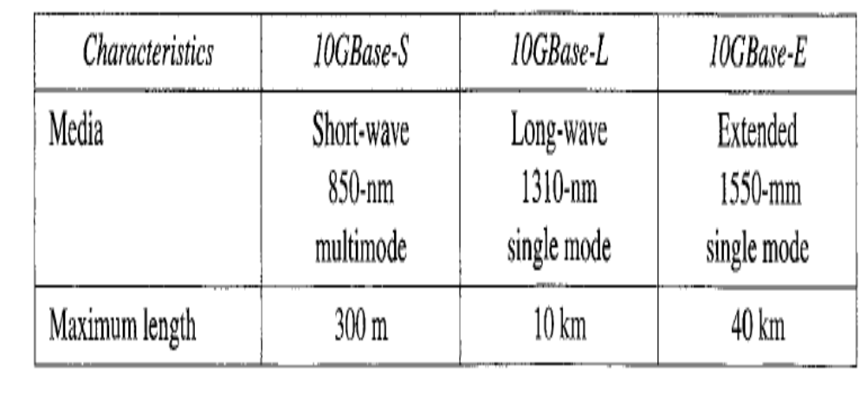

Slide 99
TOKEN BUS: IEEE 802.4
Token bus combines the features of Ethernet and Token ring.
Token bus is a physical bus that operates as a logical ring using tokens.
A token is passed among stations. If a station wants to send data, it must wait and capture the token.
Difference between the token bus and token ring is that token bus stations must know their predecessor and successor.
More suitable for real-time processing.
802.3 no limit on the no. of collisions that could occur.
Possibility for unexpected delays.

Slide 100
TOKEN RING: IEEE 802.5
Like Ethernet, token ring is a MAC protocol.
Data rates 4, 16 or 100 Mbps.
Differential Manchester coding techniques.

Slide 101
TOKEN RING: IEEE 802.5
Access Method
Stations on a token ring LAN are connected in a ring using NIC.
A station can send directly only to its neighbors, and in most cases only to one neighbor.
If a station wants to send to another station on the ring, the frame must go through all the intermediate interfaces.
Ring contention is handled through a token (special frame) that circulates past all the stations.
In Token Ring each station may transmit only one frame during each turn.
The mechanism coordinates this rotation is called token passing.
Token Ring allows each station to send only one frame per turn

Slide 102
TOKEN RING: IEEE 802.5
Operation
When a token arrives at station one of 2 things occur.
If a station has something to send it claims the token, removes it from the ring, and sends a frame in the token’s place.
The frame then travels along the ring and each station examines its destination address.
If the destination address does not match the current station’s address, the station relays the frame to its neighbor.
If it matches, the destination station copies the frame, sets some status bits in it, and routes the frame to its neighbors.
Once the frame arrives the created station, it removes the frame from the ring, generates a new token, and send the token back onto the ring.

